Slide 1
Final Presentation
Team 4

Slide 2
Team members
Seelam Mounica
Sattor Sri Harshika
Katta Chandi Priya
Bodapati Supriya
Kalla Pavan Kumar Reddy
Kandimalla Manoj Kumar

Slide 3
Goal of the project
To create a website that has easy access to students and lecturers.
To create different logins for students, faculty and admins.
To create graphical representation of students’ achievements.

Slide 4
Client’s Data
We have received several .csv files from the client. These files contain the details of the students and their grades.
We apply data manipulation techniques to sort the data in the files and merge these files, if required.

Slide 5
System Requirements
Software Requirements
Tools: Xcode 15 or higher with in-built simulator
OS: IOS 17 or higher versions
Hardware Requirements
IOS Devices: Macbook, Iphone, Ipad etc

Slide 6
Xcode
Xcode is an integrated development environment (IDE) created by Apple Inc. for developing software applications for iOS, iPadOS, macOS, watchOS, tvOS etc.
It includes a site of tools that developers can use to write, debug, and test software, as well as tools for managing project files and resources.
It can be installed from App store.
We use Swift programming language to develop the app.

Slide 7
Libraries used
Firebase: Firebase offers two primary services for managing data: Firebase Cloud Storage and Cloud Firestore. (https://github.com/firebase/firebase-ios-sdk)
DGCharts: Dgcharts provides tools that can be used for visualization of students’ records.(https://github.com/ChartsOrg/Charts.git )

Slide 8
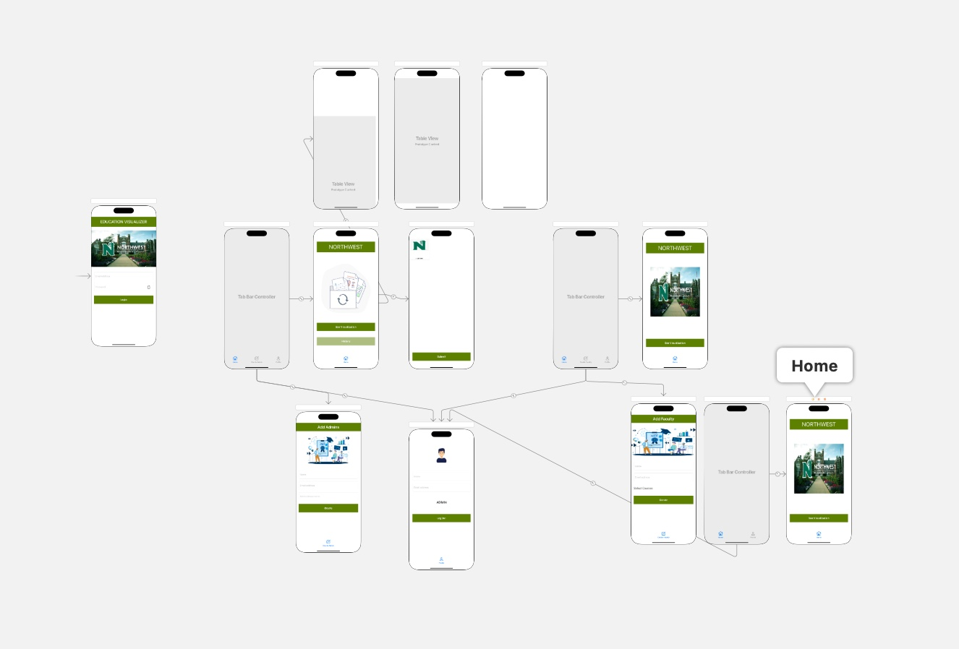
System Architecture

Slide 9
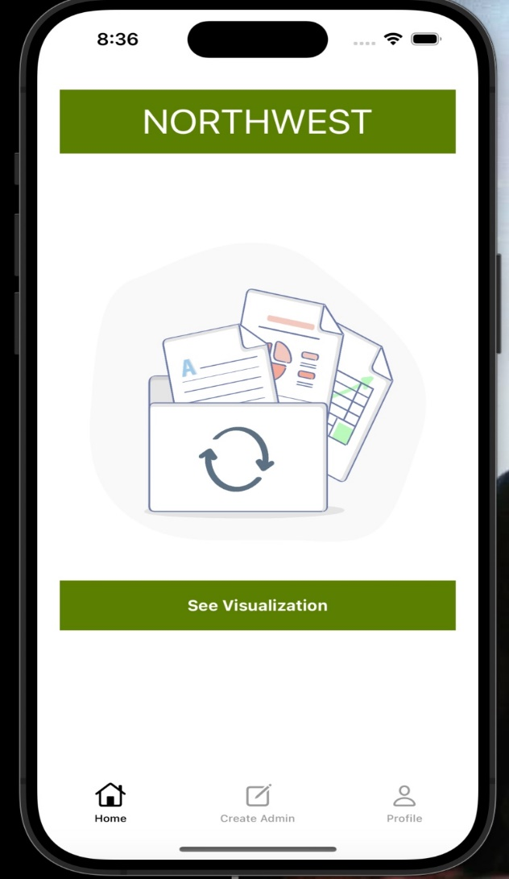
Roles and Responsibilities
Super Admin:
Have access to all the departments in the university.
Can create admins for the departments.
Upload CSV files.

Slide 10
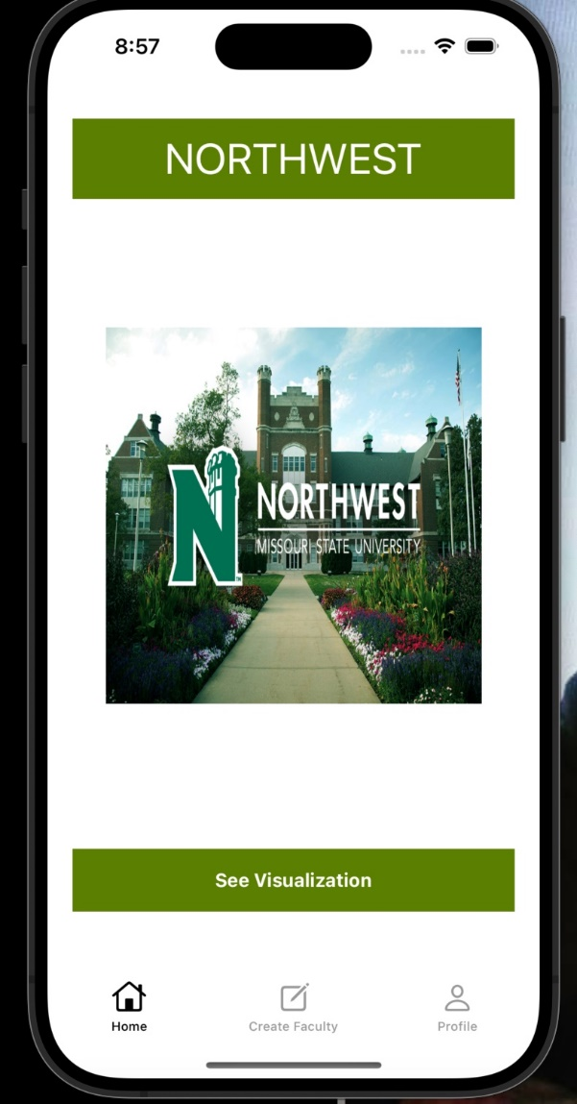
Roles and Responsibilities(contd…)
Admin:
Have access to the courses in his/her department.
Can create faculty for the courses in their department.
Can see visualization of all the courses in their department.

Slide 11
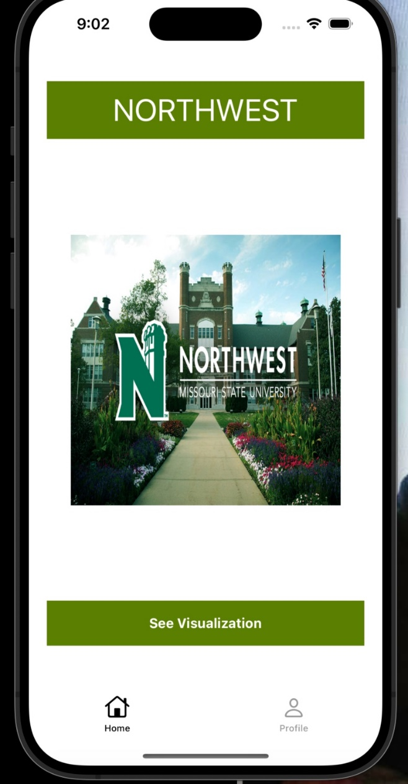
Roles and Responsibilities(contd…)
Faculty:
Have access to the courses that he/she is teaching that semester.
Can see visualization of all these courses.

Slide 12
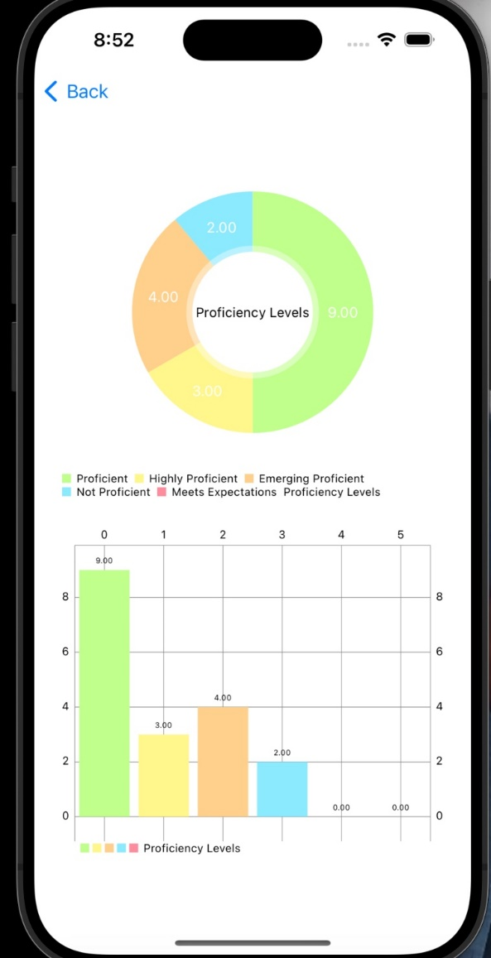
Visualizations
We have visualized the students’ records using pie chart and bar graph.

Slide 13
Contribution
Team Member | Work done | Percentage
Mounica Seelam | Woked on UI and implementation of code of the app. | 100%
Sri Harshika Sattor | Woked on UI and implementation of code of the app. | 100%
Supriya Bodapati | Worked on data cleaning and UI | 100%
Katta Chandi Priya | Worked on authentication and firebase integration. | 100%
Pavan Kumar Reddy Kalla | Worked on firebase integration and visualization. | 100%
Manoj Kumar Kandimalla | Worked on visualization and data cleaning. | 100%

Slide 14
Conclusion
Our main aim of the project is to build an IOS application(which is something like a replica of Coursetune app).
This application contains all the schools and degrees offered by the university.
This application provides access to three roles they are Admin, faculty and super admin in the university.

Slide 15


